Slide 1
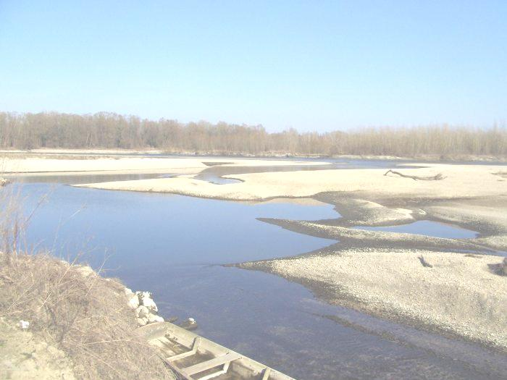




Facts about water

Slide 2
Scientific facts about water

Slide 3
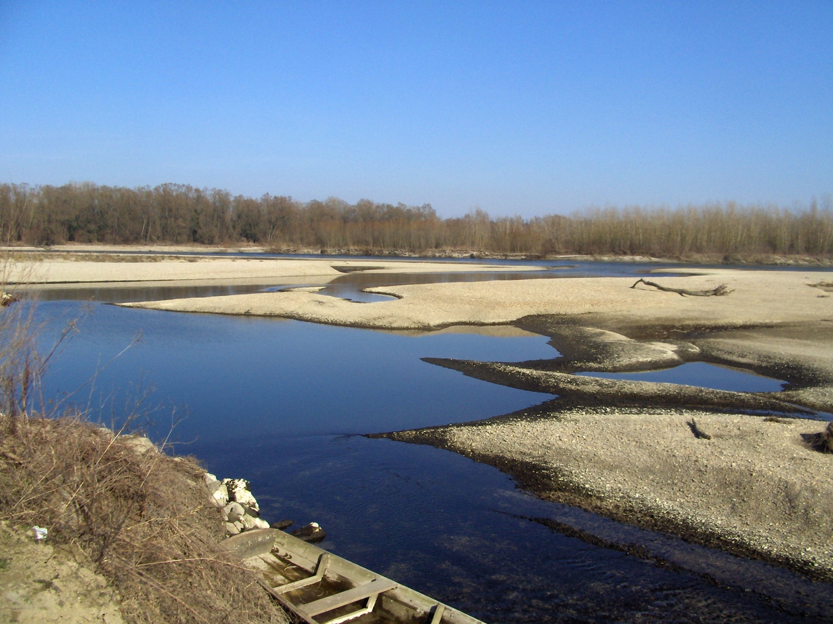
Much more fresh water is stored under the ground in aquifers than on the Earth’s surface..

Slide 4
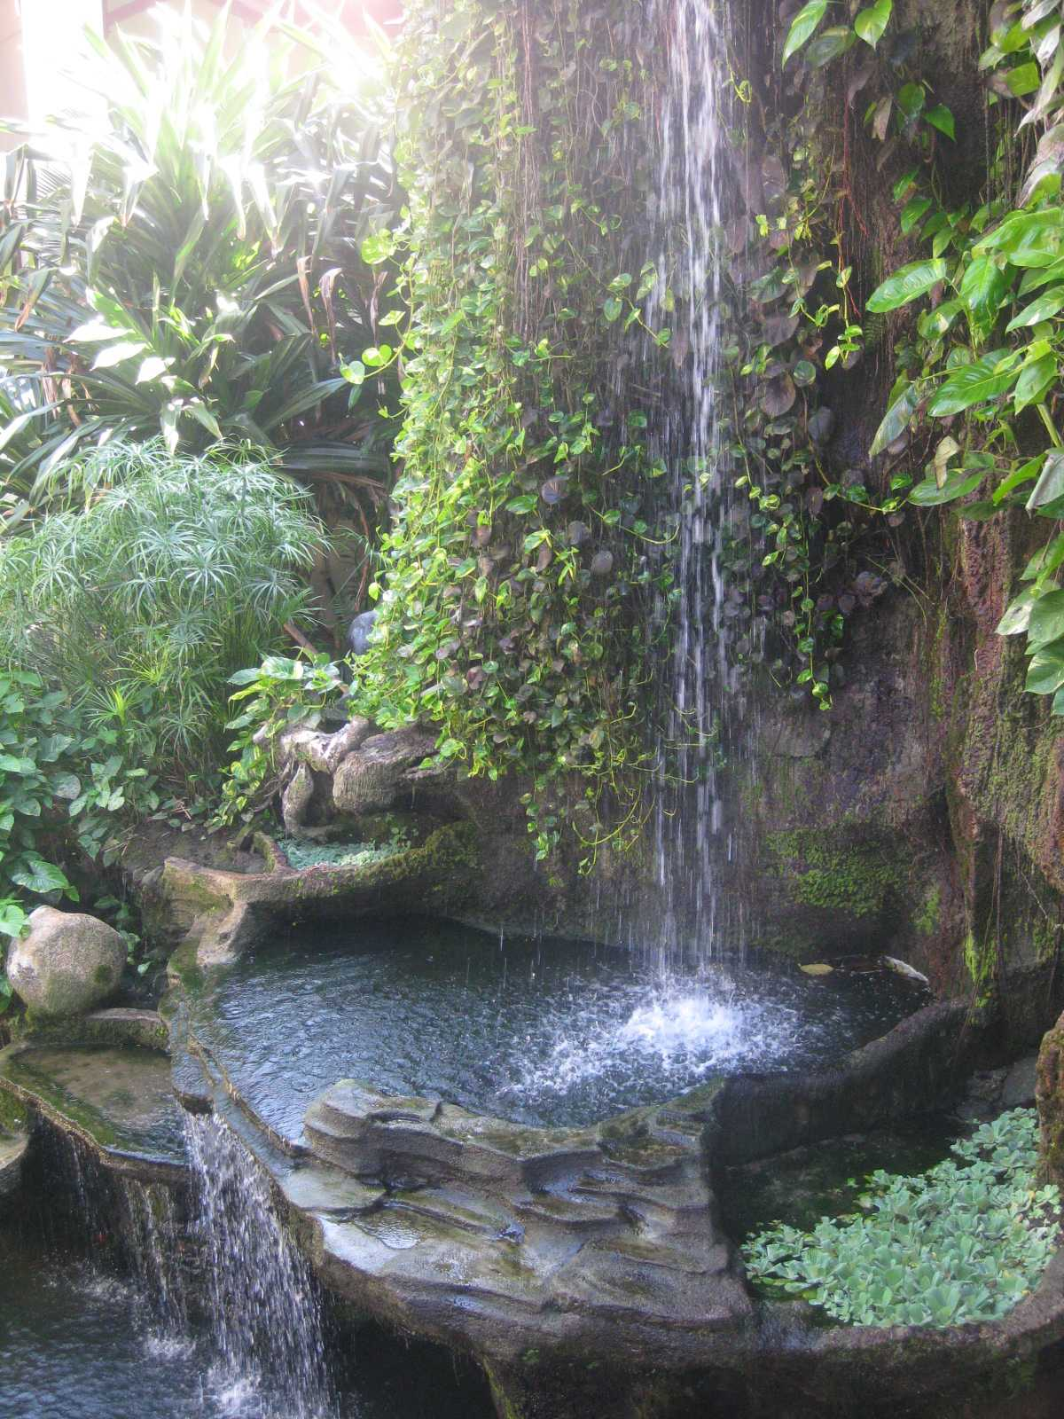
Research shows that goldfish memorize things better in cold than in warm water.

Slide 5

Water memory is the claimed ability of water to retain a "memory" of substances previously dissolved in it to arbitrary dilution.
Some scientists support this thesis, others don't.

Slide 6
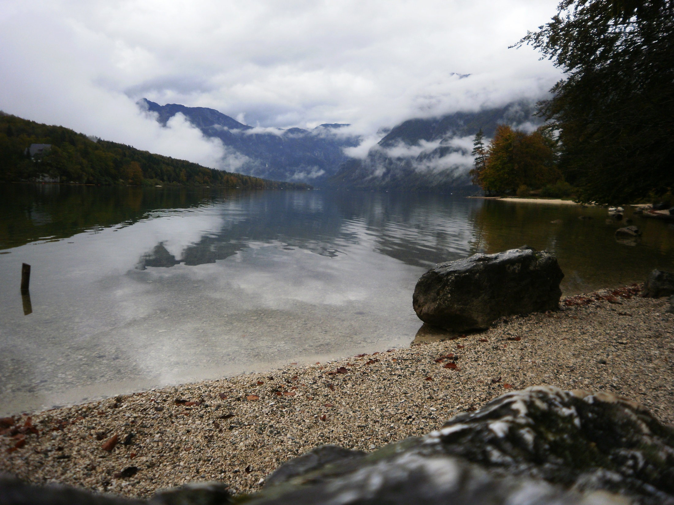
Water has 19 states of matter! We've known since elementary school that water has three states of matter– liquid, solid and gas. However, scientists can distinguish 5 different states of water while it is in liquid form, and up to 14 while it is in solid form.

Slide 7
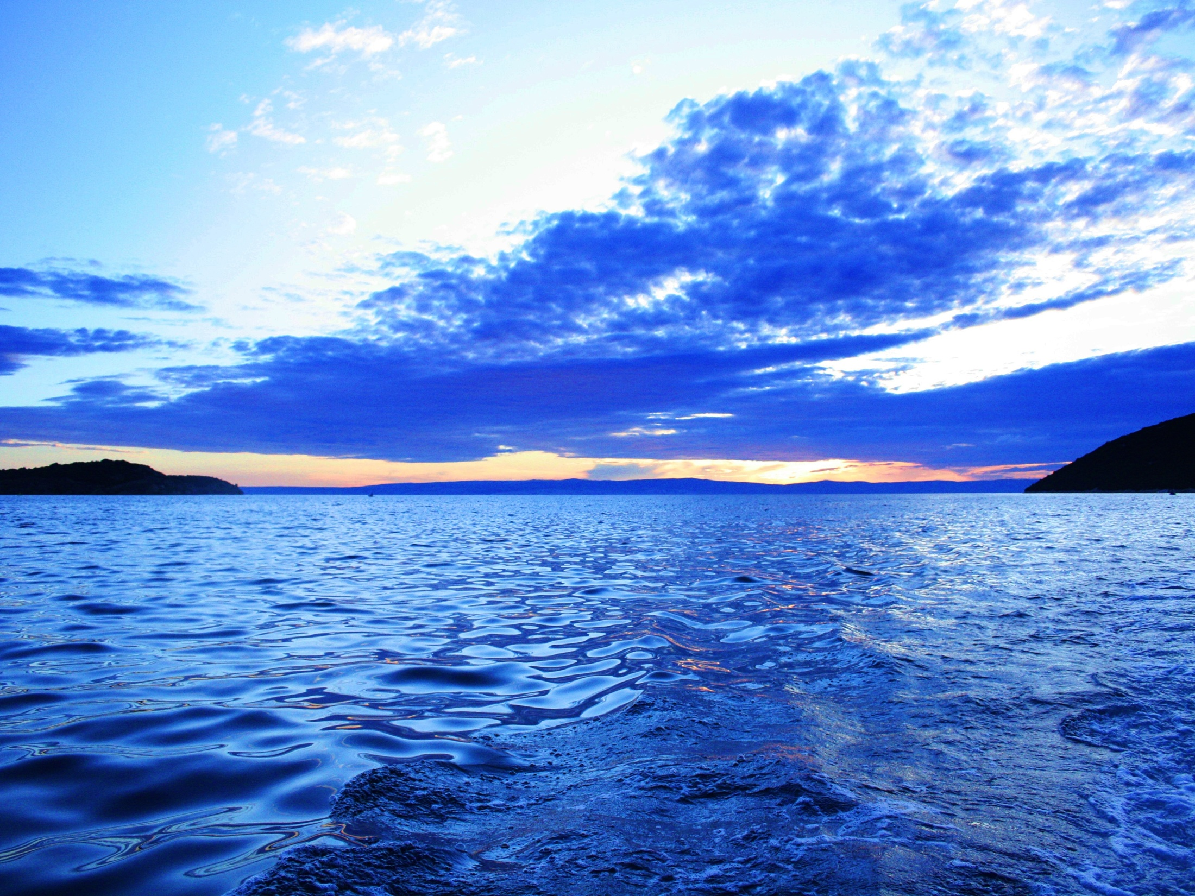
Many women and young girls in Sub-Saharan Africa must walk an estimated six miles every day to get enough water for their families. This daily task prevents many from pursuing education or earning extra income.

Slide 8
Interesting facts about water

Slide 9
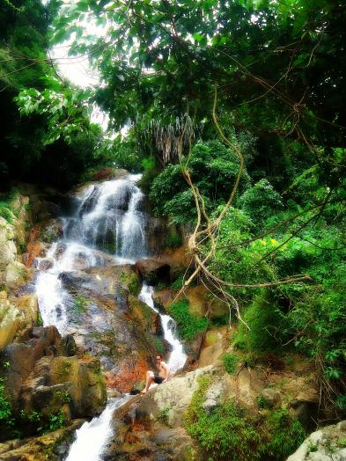
'Water Pump', 'Dead Fish' and
'All American' are the
names of three basic
handshaking techniques.

Slide 10
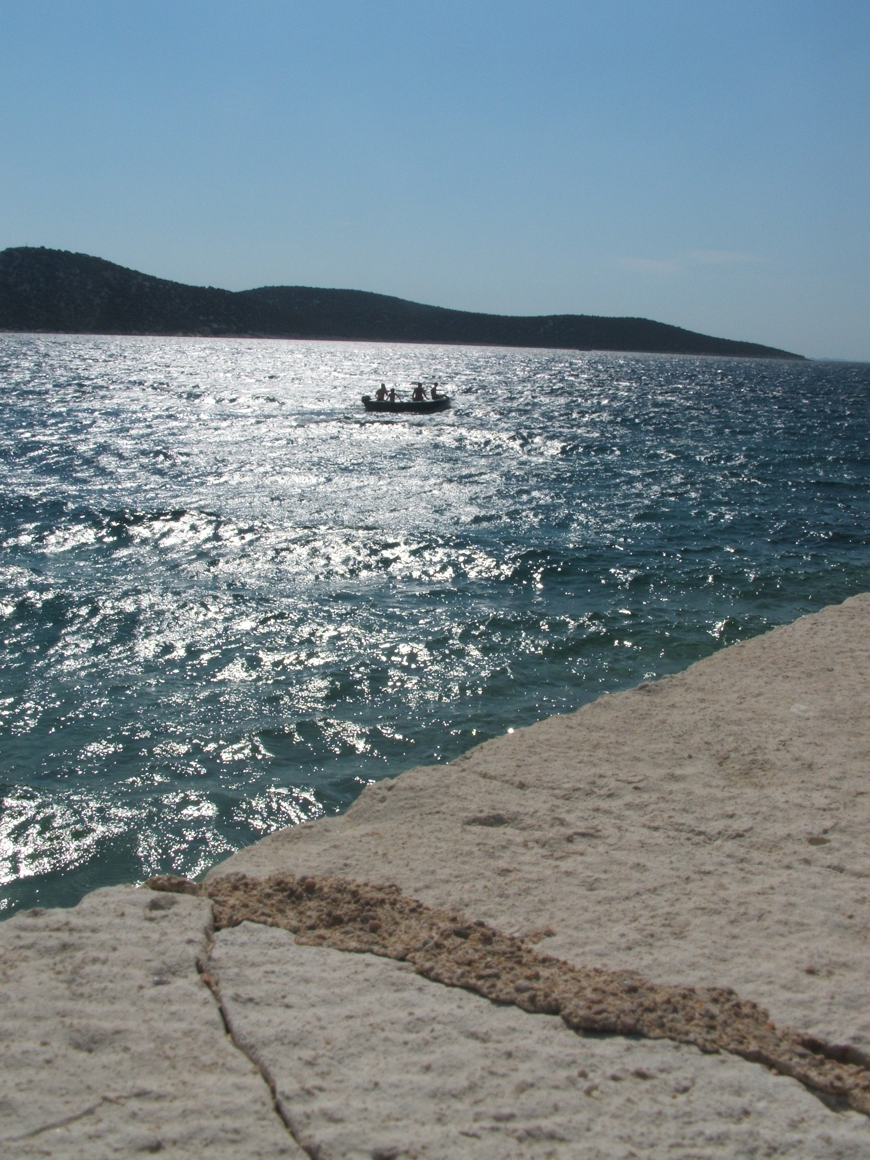
During the New Year's celebration in Cambodia it is illegal to use water pistols.

Slide 11
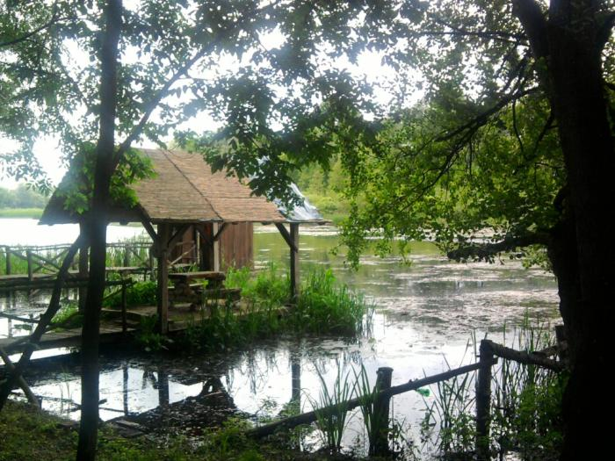
The weight a person loses directly after intense physical activity is weight from water, not fat.

Slide 12
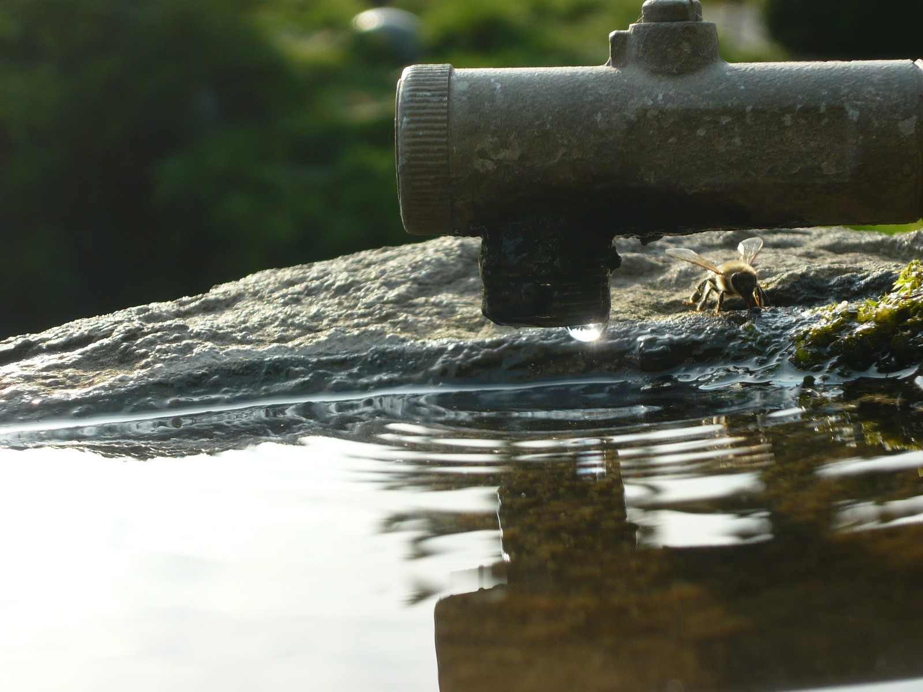
There is about the same amount of water on Earth now as there was millions of years ago.

Slide 13
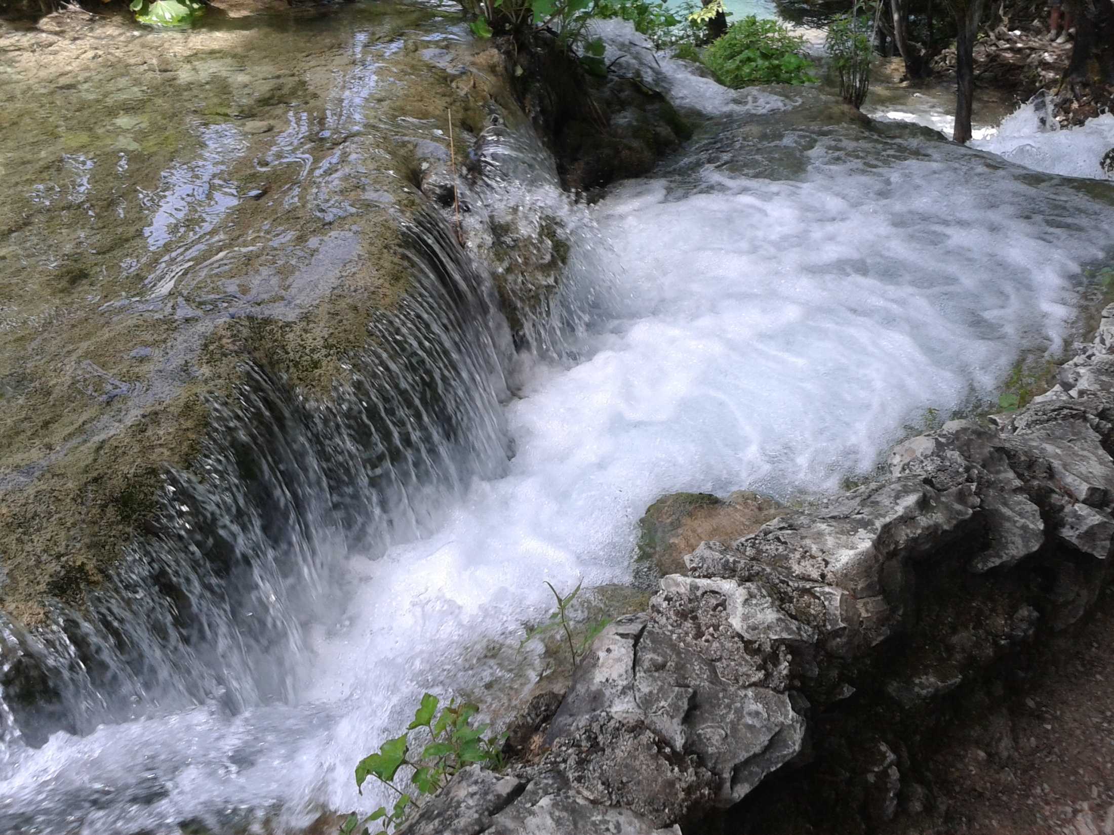
Although 70 percent of the Earth's territory is covered with water, only 1 percent of that water is drinkable!

